Slide 1


Green Pace
Security Policy Presentation
Developer: Brandon Ayers

Slide 2

OVERVIEW: DEFENSE IN DEPTH
This security policy was created to ensure and enforce secure development processes are in place at Green Pace through principles, standards, and automated checks. Defense-in-depth is used by implementing multiple layers of protection. The goal is to embed security through the entire process to ensure security and reduce vulnerabilities overall.

Slide 3
THREATS MATRIX
Likely: Issue is to be expected
Priority: Issue is important and urgent. Could cause serious issues.
Low Priority: Issue has minimal impact
Unlikely: Issue is not expected.
Likely STD-002-CPP STD-008-CPP | Priority STD-003-CPP STD-004-CPP STD-007-CPP
Low priority STD-010-CPP | Unlikely STD-001-CPP STD-005-CPP STD-006-CPP

Slide 4
10 PRINCIPLES
PRINCIPLES | MATCHING STANDARDS
Validate Input Data | STD-001, STD-003
Heed Compiler Warnings | STD-005
Design for Security | STD-004
Keep It Simple | STD-002, STD-008, STD-010
Default Deny | STD-006
Least Privilege | STD-001, STD-002
Sanitize Data | STD-003, STD-004
Defense in Depth | STD-007
QA Techniques | STD-005, STD-007, STD-009
Secure Coding Standards | STD-006, STD-008, STD-009, STD-010

Slide 5
CODING STANDARDS
RANK | STANDARD | THREAT LEVEL | REASON FOR RANK
1 | STD-004-CPP | 5 | SQL injection is easy to exploit and has severe impacts.
2 | STD-003-CPP | 4 | Not sanitizing strings is susceptible to injection.
3 | STD-007-CPP | 4 | Poor Exception handling causes severe stability issues,
4 | STD-002-CPP | 3 | Over-privilege can increase the risk of unauthorized actions.
5 | STD-005-CPP | 3 | Memory issues can cause unexpected behaviors and crashes.
6 | STD-008-CPP | 3 | Not checking allocation can leak to faults or leaks.
7 | STD-009-CPP | 3 | Bounds errors tend to be common and can be exploited
8 | STD-001-CPP | 2 | Input validation is critical, but the impact can range.
9 | STD-006-CPP | 2 | Misuse of assertions can be dangerous and overlooked.
10 | STD-010-CPP | 2 | Complex error logic isn’t severe but will hurt reliability.
The ranking was done based on threat level, impact, and exploitability combined. This will help developers know which areas should be focused on first while still remembering to adhere to all standards.

Slide 6
ENCRYPTION POLICIES
At Rest: Use secure encryption such as AES-256 for databases and files stored on disk. This ensures that any data that is stolen cannot be recovered.
In Flight: TLS 1.2 or higher should be used on all network traffic. This ensures the connection between the client and server is secure.
In Use: TME should be used to protect data that is being processed. Memory encryption is important to ensure any data being passed through the CPU is secure.

Slide 7
TRIPLE-A POLICIES
Authentication: MFA must be used to ensure user is allowed access. All logins must be tracked and logged to ensure MFA has not been breached.
Authorization: RBAC is required. This ensures the user only has access to the data they are given permission to access. This should also include least privilege by giving users the least permission needed.
Accounting: All logins, file accesses, and database changes must be logged for 200 days. These logs will be audited to ensure any issues are caught.

Slide 8
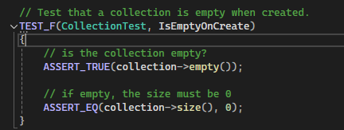
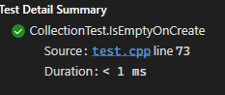
Unit Testing
Collection is empty when created.

Slide 9
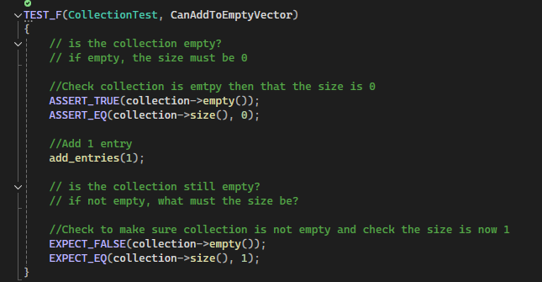
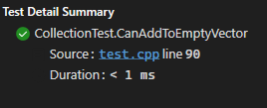
Unit Testing
Can add to empty vector.

Slide 10
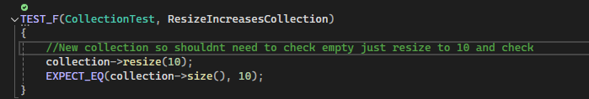
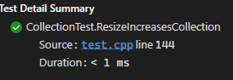
Unit Testing
Resizing collection increases size

Slide 11
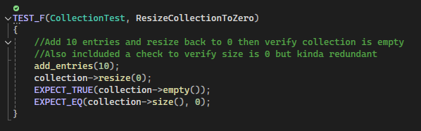
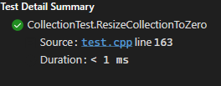
Unit Testing
Collection is empty when created.

Slide 12
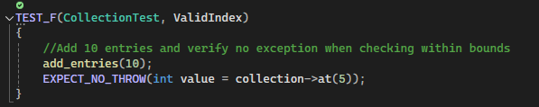
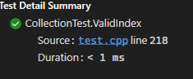
Unit Testing
Check for a valid index.

Slide 13
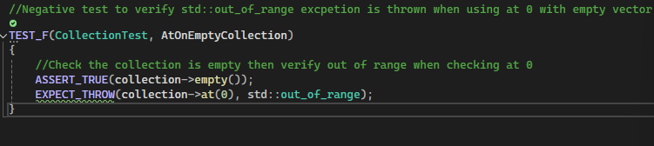
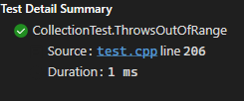
Unit Testing
Test to verify out_of_range exception is thrown when checking an empty vector.

Slide 14

AUTOMATION SUMMARY

Slide 15
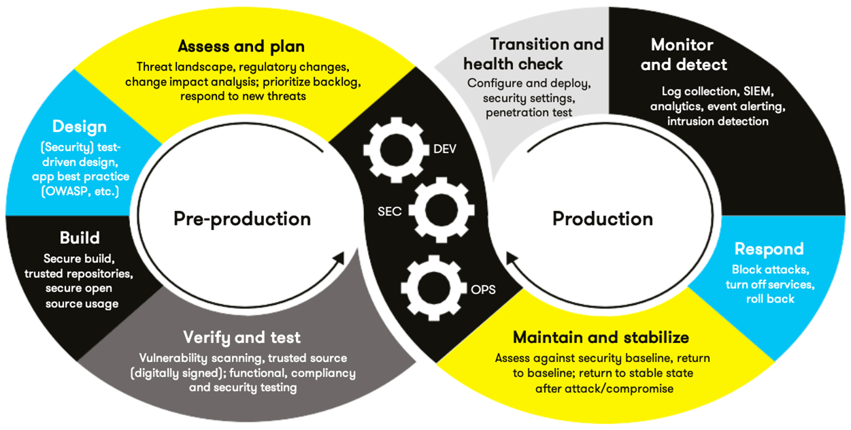
TOOLS
Plan: Define policies
Design: Incorporate standards
Build: CppCheck, Fortify.
Verify: Static & Dynamic analysis
Release: Signed and approved
Monitor: Logging and alerts
Respond: Patch Rollouts
Maintain: Schedule audits
Security tools used will be CppCheck, Static Analyzer, SonarQube, Valgrind, and Coverity. These tools will be used during the build, verify, and release stage to ensure code is secure and ready to be released.

Slide 16
RISKS AND BENEFITS
Problem: Insecure coding reaching production is a major issue and will result in problems down the road quickly.
Solution: Early detection can ensure fixes are done before release.
Risk: Hacks, data loss, and high-cost fixing issues.
Benefits: Lower security cost in long term, and fast releases.
Delayed: High risk of exposure and longer time to fix issues.
If Now: Less risk of exposure, better security, and less time to fix issues.

Slide 17
RECOMMENDATIONS
Gaps Identified:
Manual input validation
Early-Stage automation
Recommendations:
Dev onboarding and future training to ensure policies outlines are followed.
Monitor Logs using alert thresholds.
Mandatory static scans

Slide 18
CONCLUSIONS
Security must be high on the priority list during the entire process.
Training for new employees and follow up training for employees already hired.
Enforce the policy to ensure it’s being adhered to.
Review policies yearly and after incidents to make improvements.
Adopt new security standards.

Slide 19
REFERENCES
National Institute of Standards and Technology (NIST). (2023). Secure Coding Guidelines. https://csrc.nist.gov
OWASP Foundation. (2023). Top 10 Security Risks. https://owasp.org/www-project-top-ten/

